Slide 1

FMD OUTBREAK: A Practical Example of Adressing Gaps in Control Strategy
Dr Gaolathe Thobokwe
Botswana Vaccine Institute

Slide 2
HISTORY OF FMD IN BOTSWANA
(1963 to 2011)
Year(s) | 63 | 64 | 65 | 66 | 67 | 68 | 69-76 | 77 | 78 | 79 | 80
SAT virus type | 3 | 3 | 3 | 3 | Nil | 1 | Nil | 1,2 | 1,2 | 1,2 | 2

Slide 3
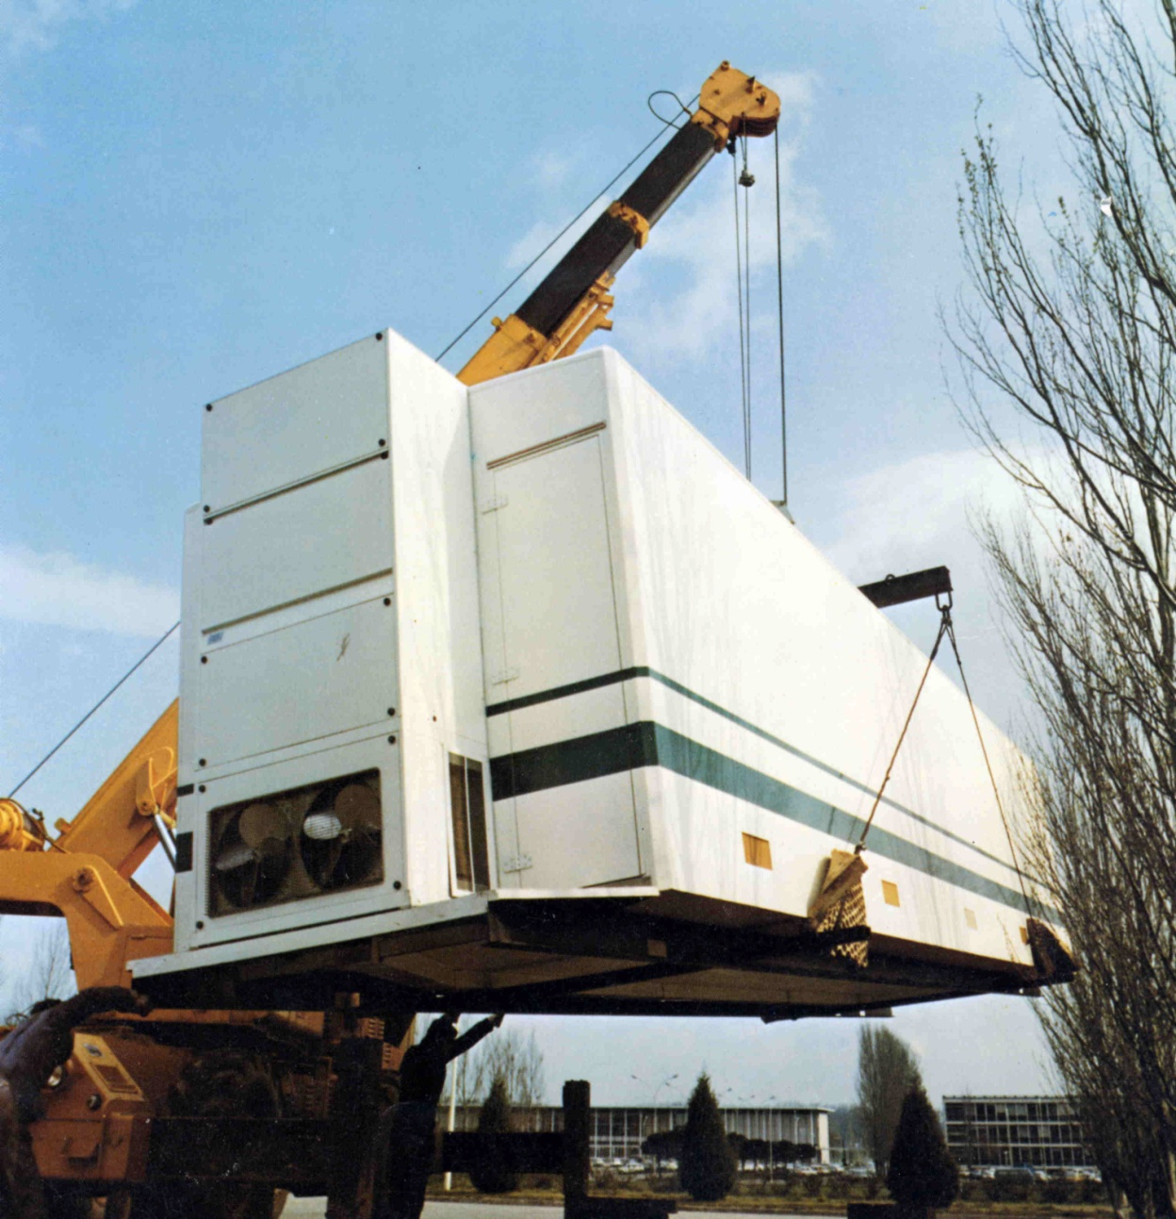
Laboratory Module

Slide 4
Strategies for disease control
Movement control/restriction (fences)
Separation between the reservoir animal and livestock
Eradication/stamping out
Public education
Vaccination

Slide 6
HISTORY OF FMD IN BOTSWANA
(1963 to 2011)
Year(s) | 63 | 64 | 65 | 66 | 67 | 68 | 69-76 | 77 | 78 | 79 | 80 | 02 | 03 | 05 | 06 | 07-2011
SAT virus type | 3 | 3 | 3 | 3 | Nil | 1 | Nil | 1,2 | 1,2 | 1,2 | 2 | 2 | 1 | 2 | 1,2 | 2

Slide 7
SAT 2, 2005, 2008, 2010, SAT 1, 2006
SAT 2, 2008
SAT 2 2007-2011
SAT 2, 2002, 2011
SAT 2, 2006, 2011
SAT 2, 2008

Slide 10
INFECTED ZONE
3,849 CASES

Slide 11
38% vaccinated
62% Unvaccinated
3 8 4 9 CASES

Slide 12
1st Questions
Coverage
    How much of target population reached
    Consistency of vaccination programmes
Handling and storage
    Cold chain maintanance transport and storage
    Cold chain maintanance at field or during vaccinations

Slide 15
Initial PVM Results

Slide 16
PVM
WHY? To evaluate vaccination “Program” with the view to learn and improve on the whole program
    - Did vaccination achieve objectives and make an impact in FMD control
Program – run by people, using resources in a given context requiring quality vaccines handled and administered properly
- if properly done will take consideration of all of these factors
- review documents, interview people, observations, data on cold chains, coverage etc and serum testing
Is there any value in doing VM Post?? – probably better started during the actual vaccination campaign
main gap in SADC is lack of independent vaccine quality assurance body

Slide 17
Initial PVM Results

Slide 18
Follow up PVM Sat 2

Slide 19
%Protection over time

Slide 20
Antibody titres progression

Slide 21
Antibody titre progression in juveniles and calves

Slide 22
OTHER PVM RESULTS
Malawi and Namibia

Slide 23
Antibody titers progression

Slide 24
RECOMMENDATIONS
Increase frequency of vaccination from every 6 months to every 4 months
Increase PD50 3 to 6
And others

Slide 26
2nd Questions
Vaccine relevance
  - Is the vaccine matching???

Slide 27

& TIMELY DELIVERY
VACCINE/FIELD STRAINS
Suitable
vaccine
strain
Field
strain
By the Manufacturer based on
r1 value
vaccine potency

Slide 28

Epidemiologically Relevant Strains
& TIMELY DELIVERY
Relationship between r₁ value and PD₅₀
Outbreak
Vaccine strains
Vaccine strain: O
STOP: no protection at all
Homologous
(A Iran 05)
=> r₁ = 1
Endemic area: No need for more than 3 PD₅₀. Protection!
Field virus:
A Iran 05
r₁ > 0.3 => in endemic area, no need of more 3PD₅₀. Protection!
Vaccine A
Heterologous
(Axy)
=> r₁ ?
r₁ < 0.3
=> unlikely protection
Emergency situation, 6PD₅₀ + repeat dose => Protection/ADAPT

Slide 29
Satau
Lesoma
Pandamatenga
Kareng Feb 2011

Slide 30
Vaccine matching
R-values a bit strange – 0.06 to 0.37
New vaccine adopted – started being used Feb 2012
Took about 2 and half years
Challenges
  Initially low TCID50
  Detection by uv peak
  Transition from small bioreactors to Industrial production
More vaccine matching with other vaccine candidates

Slide 32
SADC FMD situation 2002 – 2011 (selected)
YEAR | BOTSWANA | MALAWI | NAMIBIA | ZAMBIA | ZIMBABWE
2002 | SAT 2 |  |  |  | SAT 2
2003 | SAT 1 |  |  |  | SAT 1
2004 |  |  |  | SAT 1
2005
2006 | SAT 2 and 1
2007 | SAT 2 | SAT 2 | SAT 2 | SAT 2
2008 | SAT 2 | SAT 2 | SAT 2 | SAT 2/1
2009 | SAT 2 | SAT 2 |  | SAT 2
2010 | SAT 2 | SAT 2 | SAT 1 | O | SAT 2
2011 | SAT 2 |  |  |  | SAT 2?

Slide 33
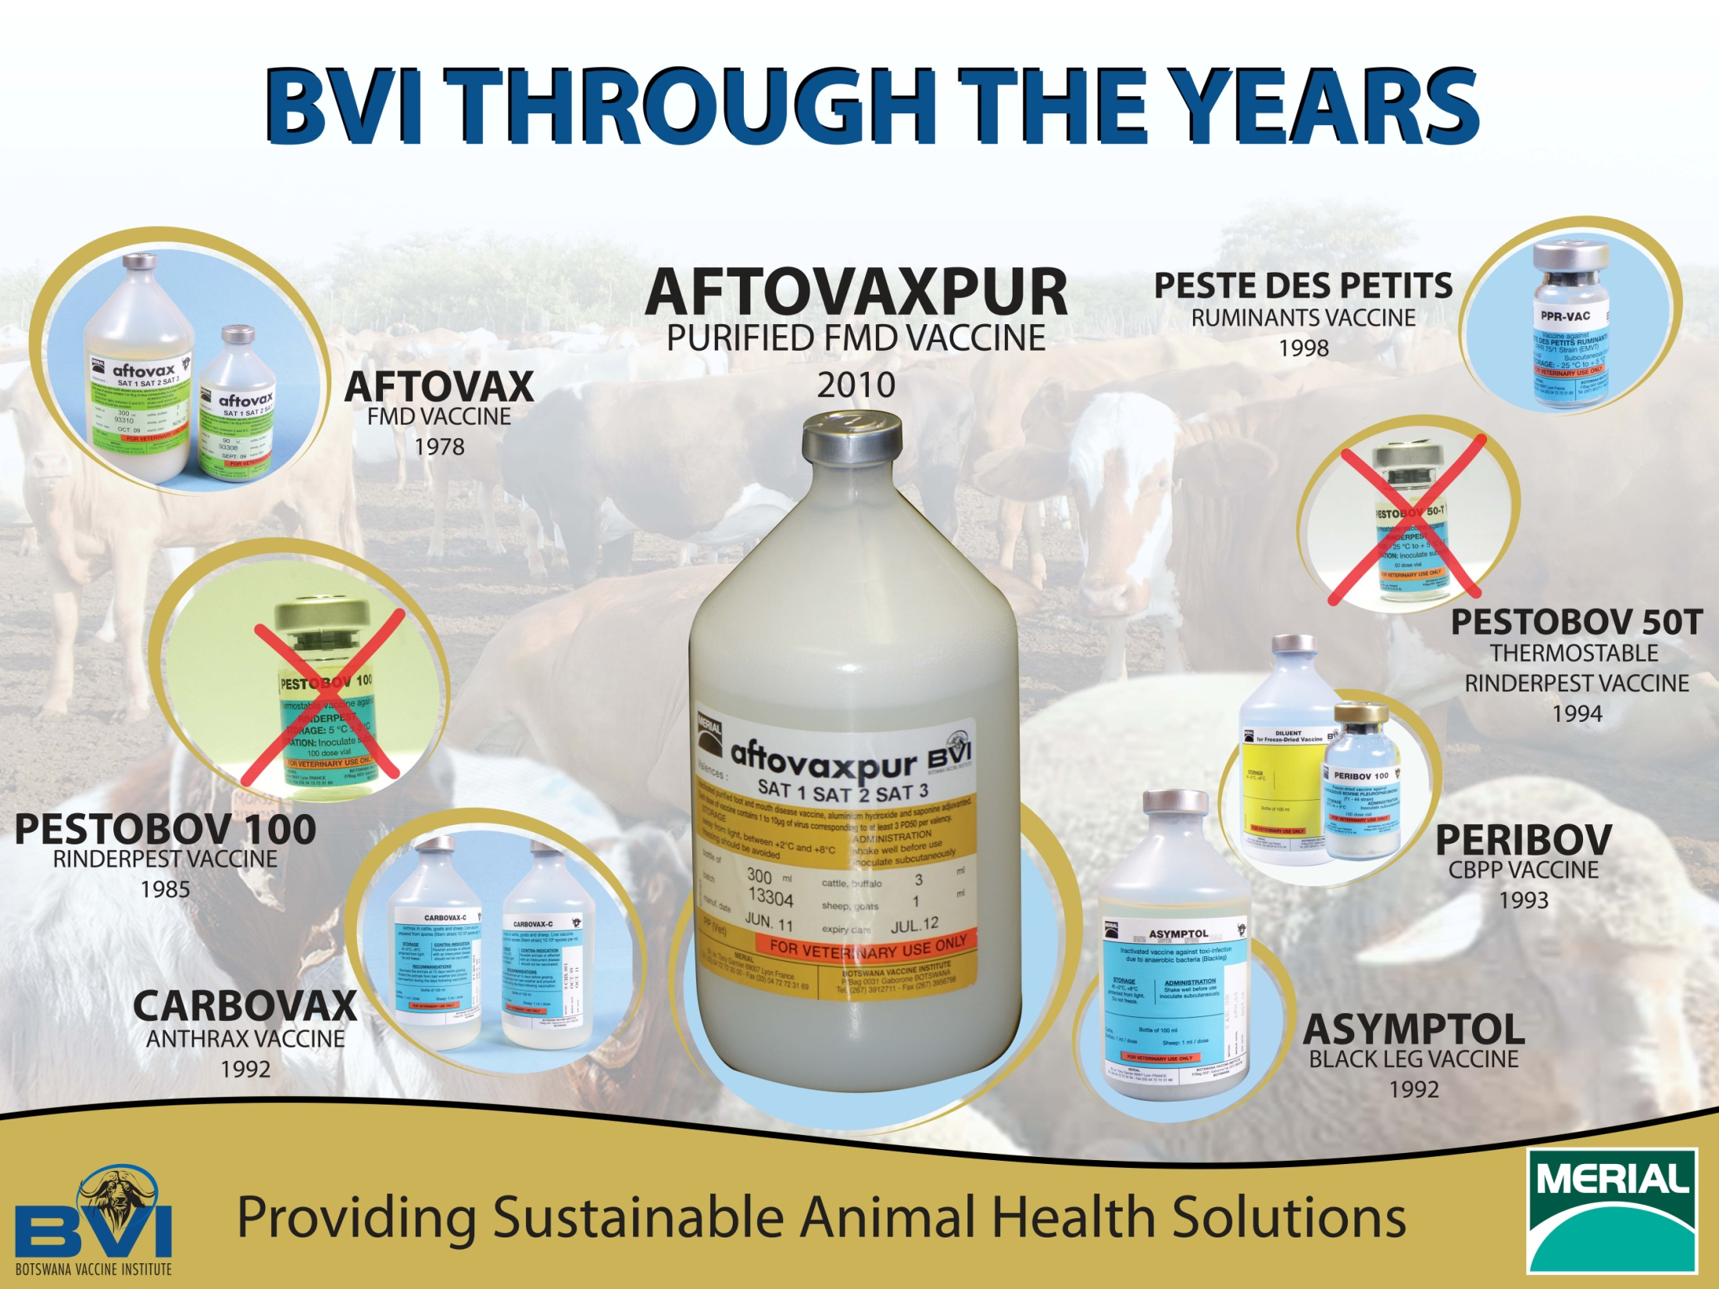
Launched 04 Nov 11

Slide 34
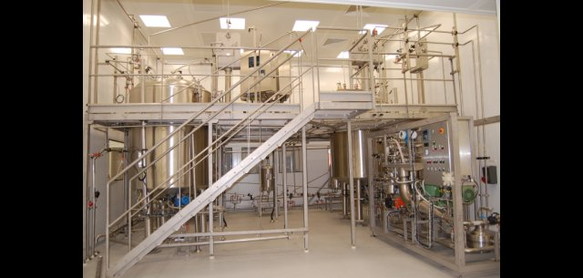

Slide 36
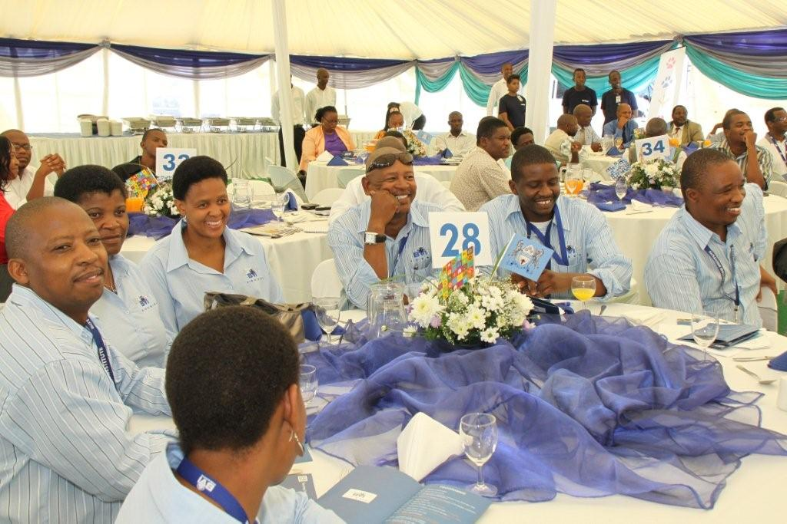
Lab Officialy opened 2nd December 2010
Product launch 4th November 2011

Slide 37
Project Drivers
Technology update
Ergonomic design
Capacity increase
Antigen purification
Antigen bank
Quality improvements/HSE

Slide 38
Vaccine Production
Conventional
Purified
Emergency

Slide 39
Definitions
Conventional vaccines
- Vaccines produced from semi-purified inactivated antigens, with a potency greater than 3 PD50
Purified vaccines
- Vaccines produced from highly purified inactivated antigens, with potency greater than 3 PD50
Emergency vaccines
- Vaccines produced from highly purified, concentrated and frozen antigens, with a potency greater than 6 PD50

Slide 40
NSPs AND “DIVA” VACCINE
BVI Vaccines are compatible with a DIVA approach.
=> DIVA:
- Previously: Differentiate Infected from Vaccinated Animals.
- Recently: Detection of Infection in Vaccinated Animals
Several diagnostic tests to detect NSPs (2C, 3A, 3B,3AB, 3ABC, 3D)

Slide 41
Purified vaccine Perfomane
Vaccine blended in December 2010 with antigens produced second semester 2010 in the new building
  Payload adjusted to guaranty 3PD50 target
  Trivalent (SAT 1 2 3) vaccine with current vaccine strains used in Botswana
Vaccination at BVI ranch
  Primo vaccination at D0 booster at D28 and D150
  Blood sampling at D0, D21, 28, 42, 63, 120, 191
  Safety monitored by rectal temperature and clinical signs (local and generalreactions)
Serological testing
  Virus neutralization test (VNT)
  Non Structural Protein (NSP) testing with Prionics kit

Slide 42
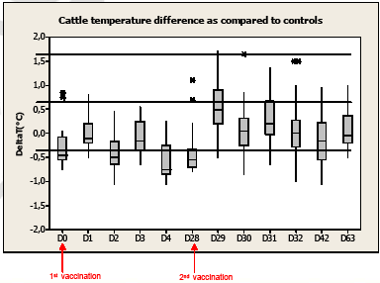
SAFETY MONITORING
Temperature monitoring:
    - No significant
    difference between
    vaccinated cattle
    and control
Clinical signs:
    -No general and local reactions
    -No weight loss
Safety conform

Slide 43
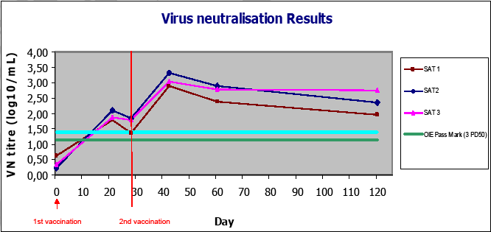
Potency
Potency results conforms

Slide 44
What we want to achieve with vaccination

Slide 45
Vaccine Application
Vaccination of susceptible livestock
  Vaccines must be administered according to the manufacturer’s instructions
    ALSA vaccines should be administered to calves with maternal immunity at 4-6 months of age
    Calves without maternal antibodies can be vaccinated at 2 weeks
    The primary vaccination course consists of 2 vaccinations 2-4 weeks apart
    Thereafter the vaccine should be administered every 4-6 months
    Should be given subcutaneously in the neck area

Slide 46
HERD LEVEL IMMUNITY
Vaccine take is expected after 7-10 days with expected protection level of 97% depending on PD₅₀ ( 3 or 6)
Cattle are normally considered protected from FMD where antibody titres exceed a certain cut off
Thereafter antibody levels decline
Important that after vaccination at least 80% of herd should have protective antibodies (D28 to 35)
Vaccination prevents disease expression but not infection

Slide 47
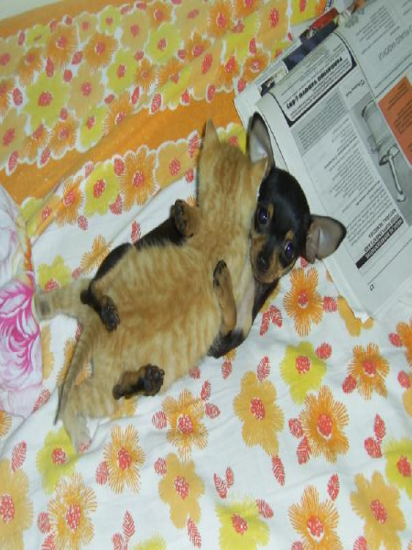
THANK YOU

